Slide 1
Distribution network Optimization Definition of strategies to minimize total costs in a retail warehouse and maximize efficiency.
Professors: Pedro Amorim, Sérgio Castro, Daniela Fernandes
George Gittins | Judith Geissler | Konsta Saranpää | Pim Gäfvert

Slide 2
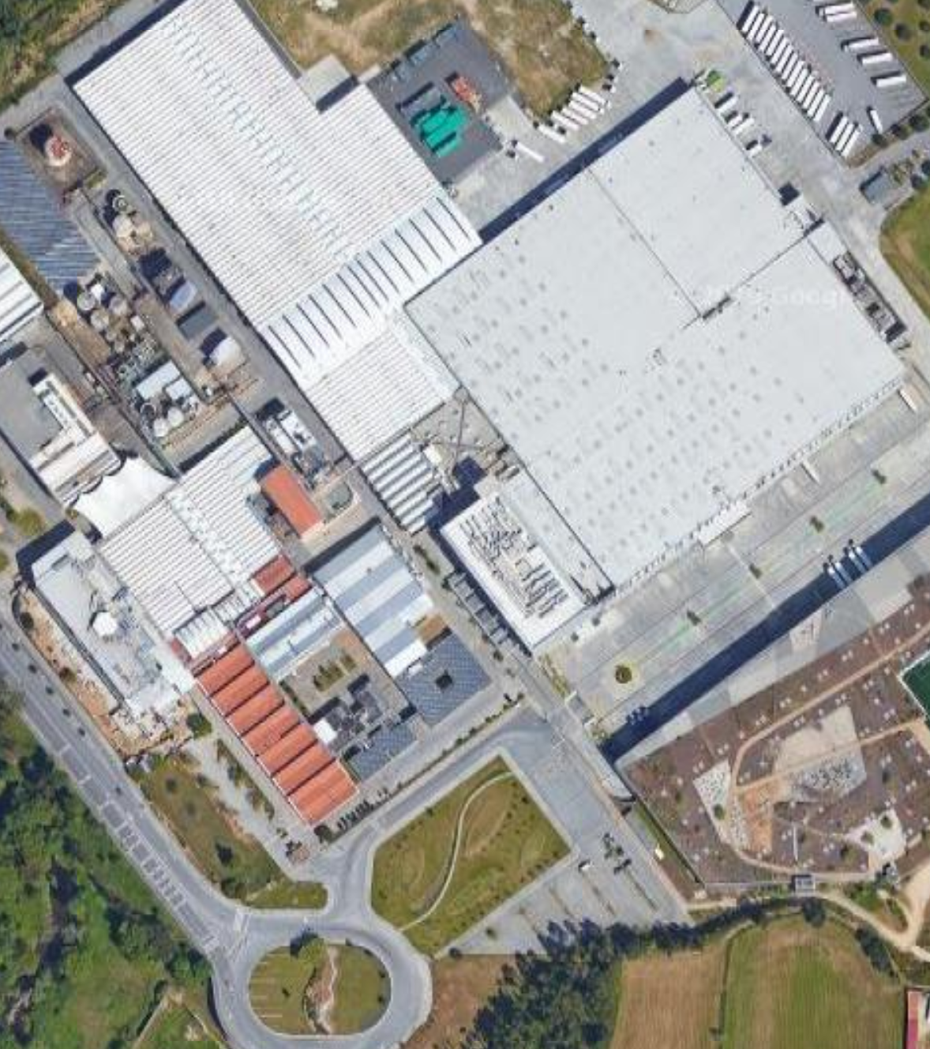
Problem Overview
Task Breakdown
Dataset Analysis & Data Preparation
Solution Description
Solution Results & Analysis
Solution Evaluation
Contents

Slide 3
1. Problem Overview
‹#›

Slide 4


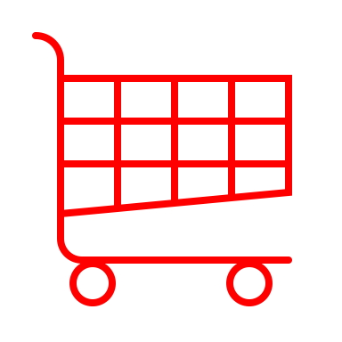











With over 35 years of experience, MC is leading company in the food retail sector in Portugal.
Over the last three decades, MC has been strengthening its leading position in the food retail sector in Portugal. MC's activity began in 1985, within the Sonae Group, with the opening of the first hypermarket in Portugal. Today MC owns 12 brands and has a vast portfolio of high quality products and services.
More than 5.978M € turnover
Network with +1.400 stores
+ 4M customers served weekly
+ 38.000 employees

Slide 5

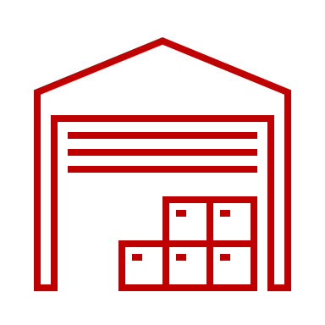


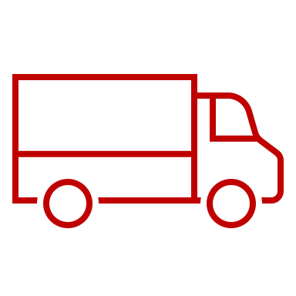

Addressing Sonae's Challenge: Optimizing Transportation Networks and Fleet for Expanding Proximity Stores
Main processes currently being used
Challenge:
Optimize transport for cost-efficient expansion of proximity stores.
Warehouses
Two picking methods:
PBL: Supplier boxes sent to stores throughout the day (no stock)
PBS: Supplier pallets stored in the warehouse, boxes picked per store
Pallets grouped by store for shipment
Transport
Warehouse staff load pallets
Single truck may ship multiple stores
Truck carries pallet groups for cross-docking
Cross-docking
Pallets sent to cross-docking for grouping
Platforms: Unloading, Ground Sorting, Loading
Single truck may ship one or more stores
Store
Daily deliveries at set time slots
Separate slots for fresh and dry goods
6-day delivery frequency (Mon-Sat)
How?
Utilize data-driven logistics models to optimize routes and fleet allocation.

Slide 6
2. Task Breakdown
‹#›

Slide 7
Strategic Focus: Goals and Objectives
Minimize costs:
Find a solution with the lowest sum of fuel, driver, vehicle and warehouse costs.
100% service level:
Optimize transport for cost-efficient expansion of proximity stores.
Maximize efficiency:
Prioritize Early Deliveries, Load Trucks Fully, Optimize Fleet Size.
How?
Optimize key cost drivers in logistics
How?
Efficient Order Assignment, Timely Arrivals, Loading Optimization, and Delivery Time Adherence
How?
Optimize delivery times, minimize underfilled trucks & number of trucks used

Slide 8


To minimize total costs, we must optimize key cost drivers in logistics
Warehouse Costs
Space monthly cost
10€/sqm
General expenses
Dry areas
2€/sqm
Cold areas
4€/sqm
R13
95€/day
Vehicle Costs
SR24
110€/day
Minimize total costs
SR33
110€/day
R13
0,40€/km
Fuel Costs
R24
0,45€/km
R33
0,50€/km
R13
11€/h
Driver Costs
R24
11€/h
R33
11€/h

Slide 9
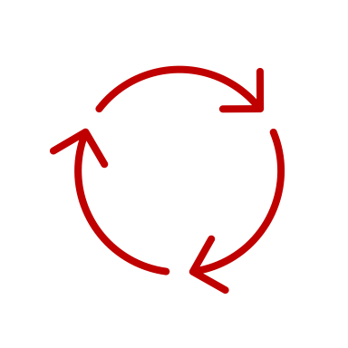
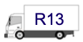
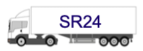
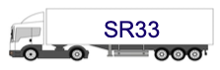
There are 3 aspects related to vehicles that need to be considered
Pallet capacity
Fuel costs
Maintenance costs
Driver costs are 11€/h for all vehicles
Pallet capacity: 13
Fuel costs: 0,40€/km
Maintenance costs: 95€/day
Pallet capacity: 24
Fuel costs: 0,45€/km
Maintenance costs: 110€/day
Pallet capacity: 33
Fuel costs: 0,50€/km
Maintenance costs: 110€/day

Slide 10


Group Clustering Analysis: Directional Insights
N
North
Groups - 1, 2, 3, 4
West
Groups - 6, 7, 8
South
Groups - 5, 9, 10
W
S
Deliveries to each direction could be delivered together and sorted at a central cross-docking warehouse.
However, stores of different groups can’t be grouped in the same truck.
This is also only beneficial if one or more of the groups in that direction have significant variation of store vehicle size restrictions.

Slide 11


Group Clustering Analysis: Distance from DC
Close < 100km
Far > 100km away
Groups: 1, 3, 4, 6, 7, 8
Groups: 2, 5, 9, 10
For nearby locations, fuel and driver costs will usually be lower due to shorter trips.
Trips to these locations will be easier to plan and may not require cross docking because cross docking should help save on the costs of travelling to the group.
For far away locations it might be good to consider 2 drivers to allow for 20h journeys and save on fleet size and fuel costs.
Also if a distant group has many vehicle size limits then cross-docking might allow for completing the long distance trip with fewer vehicles.

Slide 12

Group Clustering Analysis: Average store distance
Close < 20km
Medium < 50km
Far ≤ 100km
Groups: 1, 7, 8
Groups: 3, 6, 9
Groups: 2, 4, 5, 10
Deliveries to these groups can likely include many stores as this would not add much time and saves on vehicle costs and long distance journeys to the group.
The advice for these groups will lie somewhere between the close and far store distances and is case dependent.
For these groups adding more stores will result in longer trips which could benefit from adding a second driver to allow for more time.

Slide 13
Clustering Groups - Vehicle type restrictions
All SR33
Groups - 1, 3, 4, 5, 9
Since all truck requirements are SR33, the best approach is to perform all deliveries with SR33 trucks and distribute the pallets among them such that they have to visit as few stores as possible.
Mostly SR33
Groups – 2 (24:1), 6 (24:1,13:2),
8 (24:2,13:1), 10 (24:1)
Since in these cases the size limit is usually due to 1-3 stores, the recommendation would be to combine orders to these stores in particular. Making use of an approach such as cross-docking will not help.
Much Variation
Group - 7 (33:25,24:12,13:57)
In group 7 there is a significant amount of vehicle limited stores and therefore many smaller vehicles will have to make the long journey to the location. Cross-docking might help here…

Slide 14
Cost Analysis: Cross-Docking Facility
Given information:
Warehouse space monthly cost 10€/sqm
Minimum area 300 sqm
Warehouse operator cost 10€/h
Expenses for dry area 2€/sqm
Expenses for fresh area 4€/sqm
Average unloading time = 15min + 60sec/pal
Average sorting time = 120sec/pal
Average loading time = 15min + 60sec/pal
Let’s calculate costs of a cross-docking warehouse when dry and fresh areas are both 100 sqm.

Slide 15
Calculating the Costs of a cross-docking location
Total Warehouse Space Area
In these calculations we use a total area of 500 sqm → This includes 100 sqm for both dry and fresh areas.
Total Warehouse Space Cost
Total Warehouse Space Cost = 500 sqm x 10 €/sqm = 5000€
Warehouse General Expenses
Dry Area Expenses= 200€
Fresh Area Expenses = 400€
Warehouse Space Monthly Cost
Warehouse Space Monthly Cost = 500 sqm x 10 €/sqm = 5000€
For group 7, the most pallets on a day that would go through the cross docking platform are:
Dry: 942 pallets
Fresh: 697 pallets

Slide 16
Total expenses
Construction Cost = Total Warehouse Space Cost + Dry Area Expenses + Fresh Area Expenses
Construction Cost = 5000€ + 200€ + 400€ = 5600€
Monthly cost = 5000€ + pallet processing costs
Pallet processing costs:
= WH Operator cost x Time spent on processing

Slide 17




Calculating the Costs of a transport to the cross-docking center
55km at 75 km/h from DC to CDP = 0.733 hours
Cap | Fuel | Driver | Vehicle
33 | 0,50€ | 11,0€ | 110,0€
24 | 0,45€ | 11,0€ | 110,0€
13 | 0,40€ | 11,0€ | 95,0€
These are optimal planning outcomes where all pallets perfectly fit and there is no mixing, but the impact should be comparable to reality!
Maximum in a day: 689 dry pallets with limit 13 → 53 trucks
529 fresh pallets with limit 13 → 41 trucks
295 dry pallets with limit 24 → 13 trucks
179 fresh pallets with limit 24 → 8 trucks
Total = 93 x cap13-Trucks & 21 x cap24-Trucks
Those same pallets with 33 limit: 942 dry pallets but 33 limit → 29
697 fresh pallets but 33 limit → 22
Total = 51 trucks
Fuel = 55 *(0.4 * 93 + 0.45 * 21) = 2565.75€
Driver = 0.733 * 11 * (93 + 21) = 919.182€
Vehicle = (93*95+21*110) * 6 = 66870€
Fuel = 55 *0.5 * 51 = 1402.50€
Driver = 0.733 * 11 * 51 = 411.21€
Vehicle = 51*110 * 6 = 33660€

Slide 18
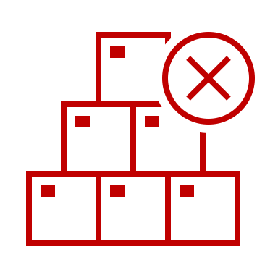
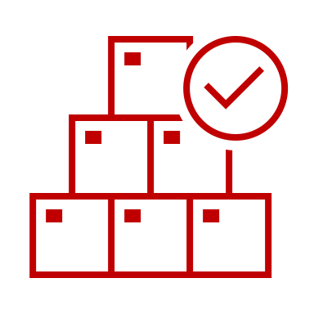

Comparing Total costs for transport from DC to cross-docking centre
Without cross docking:
2565.75€ + 919.18€ + 66870€
= 70354.93€
With cross docking:
1402.50€ + 411.21€ + 33660€
= 35473.71€
Saving per week:
70354.93€ - 35473.71€ = 34881.22€
We assume that there will be no savings driving from the cross docking location to the stores as the original limited capacity fleet is still needed for that…

Slide 19
However, the savings will be less than this due to the fleet size!
We will still need to use the same fleet whether we use a cross docking centre or not.
→ The same trucks that would have take the goods to the cross-docking centre still need to transport it to the stores.
This only adds some complication in tracking and planning where trucks need to be because we have to send the SR33 trucks back to the DC and make sure the smaller trucks are ready to pick up the goods from the cross-docking centre.
It might even increase the overall fleet size to introduce cross docking as it occupies trucks that could have been used elsewhere.

Slide 20
Comparing fuel and driver costs for transport from DC to cross-docking centre
Without cross docking:
2565.75€ + 919.18€ =
3484.93€
With cross docking:
1402.50€ + 411.21€ =
1813.71€
Saving per week:
3484.93€ - 1813.71€ = 1671.22€
Very low, does this compensate for the costs of building and operating a cross docking centre?

Slide 21


Delivery Priority Strategy: Location and Order Planning
Which locations should be delivered to first?
There are two factors to this decision:
Delivering to nearby store groups first means that
trucks will return faster for the next delivery,
thereby reducing fleet size and costs
Delivering to far store groups first means that
the long trips will be addressed first and
increases the chance that the fresh and dry daily deadlines are met
or
→ Since the first goal is to minimize costs we will initially attempt to deliver to nearby groups and if time optimizations are still needed we can look at alternative approaches
Within a group, which orders should be planned first?
We can plan them in order of two values: capacity limit and pallet volume.
Capacity Limit: The order in which we plan these should be insignificant but we should try to combine orders with the same capacity limits to avoid transporting pallets with a smaller vehicle than necessary.
Pallet Volume

Slide 22




To attain a 100% service level, specific success conditions were essential:
Full Assignment
All orders have been assigned to a delivery.
Timely arrival
No fresh order arrives later than the fresh time limit
→ (8:00am on the day after the order)
No dry order arrives later than the dry time limit
→ (23:59 on the day after the order)
If a delivery contains part of an order, the remainder of the order must arrive within 4 hours
If any of these are not met the solution fails
Loading dock capacity
40 loading docks can be in use at a time for dispatch
Delivery time limits: Single/Tandem Driver Constraints
No delivery trip can take longer than 10 hours
Trip limit may be extended to 20 hours if two drivers are assigned

Slide 23

Enabling Success: Meeting 100% Service Level Conditions
Each row in the orders table is treated as an order
whenever pallets are assigned to a row in the output table they are subtracted from the pallets column in the input table
The total number of fresh and dry pallets planned is summed and compared to the original sum of fresh and dry demand
Any mismatch is a failure
Full Assignment
All orders have been assigned to a delivery.
Timely arrival
No fresh order arrives later than the fresh time limit
→ (8:00am on the day after the order)
No dry order arrives later than the dry time limit
→ (23:59 on the day after the order)
If a delivery contains part of an order, the remainder of the order must arrive within 4 hours
All deliveries starting after 19:00 must contain fresh goods unless fresh demand is satisfied
Between 17:00 and 19:00 try to plan as many dry deliveries as possible
But don’t add part of an order too soon before 19:00 to a trip so that it has to wait until fresh demand is satisfied again is complete
When mixing, don’t add dry goods if it means exceeding the fresh goods time limit of 8am

Slide 24


Enabling Success: Meeting 100% Service Level Conditions
The first 40 deliveries of the day always start loading at 17:00
Any deliveries after that can start after any of the previous deliveries have finished loading
Loading dock capacity
40 loading docks can be in use at a time for dispatch.
When adding pallets or adding a new store to the list, always check if this addition will lead to the trip time exceeding 10 hours
If there are two drivers available then extend the limit to 20 hours but double the driver costs for that trip
Delivery time limits: Single/Tandem Driver Constraints
No delivery trip can take longer than 10 hours
Trip limit may be extended to 20 hours if two drivers are assigned

Slide 25
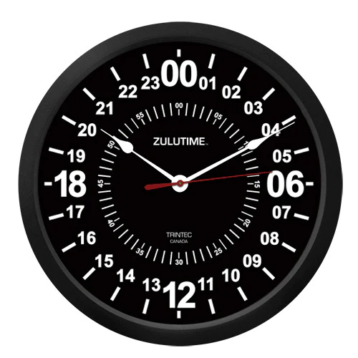

Optimizing Efficiency: Daily Delivery Schedule & Data Insights
Final deliveries leaving
01/05/2023 is Monday
Orders are picked 6 days a week (Mon-Sat)
Dry goods are ready to be shipped everyday at 5 p.m (d)
Fresh goods are ready to be shipped everyday at 7 p.m (d)
Dry goods may be delivered during all day ( d or d+1)
All fresh goods must be delivered until 8 a.m (d+1)
On the same day, all goods of the same type must be delivered in a 4h time slot of more than one delivery is made
Most/all deliveries have arrived
First deliveries arrive
Picking
Most/all trucks are back at Sonae
Fresh deliveries start leaving
Orders are processed to deliveries
Store restrictions
Dry deliveries start leaving
Pallets are organized per delivery
Trucks wait at loading docks

Slide 26
3. Dataset Analysis & Data Preparation
‹#›

Slide 27
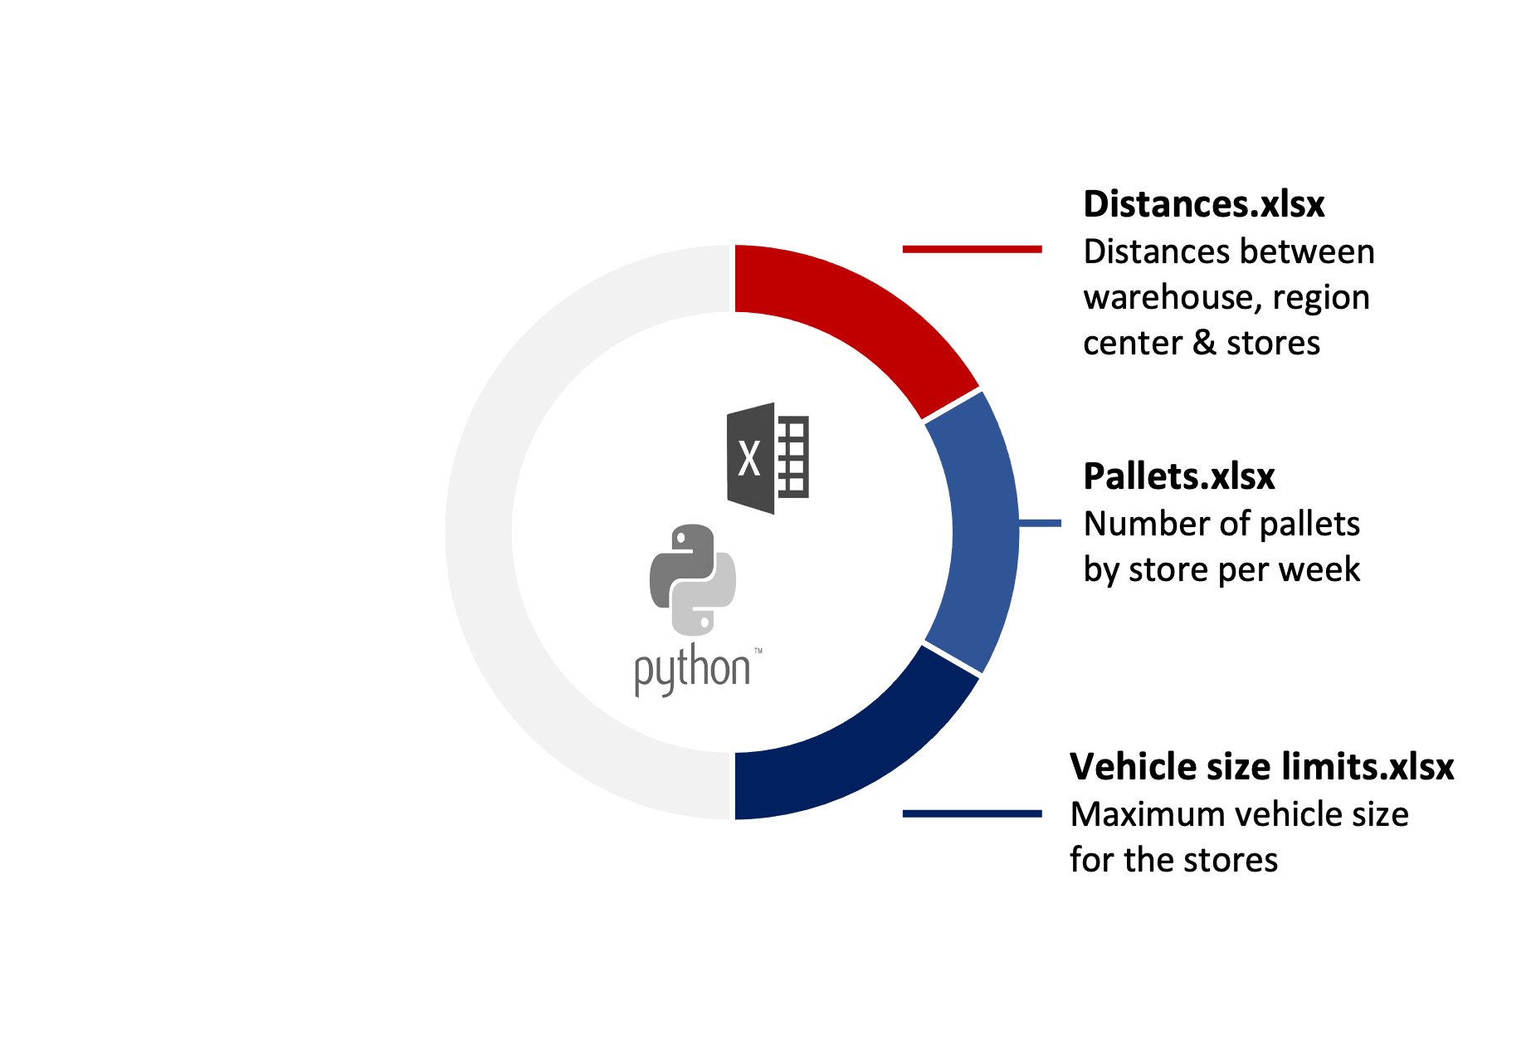
The data available was treated and processed in two different work tools: Excel and Python
Through Excel:
Each order was matched to its respective store along with:
Vehicle costs, which have been added by inserting a column each for vehicle (pallet size), fuel costs, driver costs and vehicle costs.
Through Python:
Create the initial plan-list and organize the orders for each days.
Organising deliveries by store- groups.
Planning orders for divided groups of dry and fresh goods.
Calculating remaining demand and repeating until demand is satisfied.
Add information to existing Plan-list.
Using the codes to plan the different scenarios.
We merged the three Excel files into one single document called MasterWorksheet(alldata).xlsx for easier data processing and analysis

Slide 28
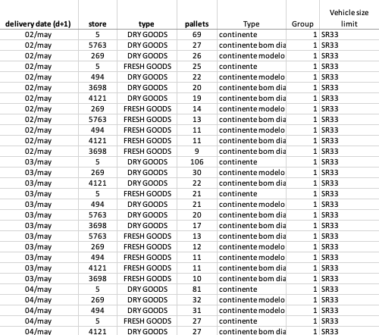
Visualizing Order Details: Exploring the Input Table
Columns of the input table – each row is an order
Delivery date (d+1): Date the order should depart on
Store: Unique number value to indicate the store
Type: type of goods of the order Either Fresh or Dry
Pallets: number of pallets in that order
Type: Shop type e.g. Continente (not used)
Group: Region group number of the store, determines distance
Vehicle size limit: Maximum size label of vehicle that can perform the last-mile delivery to this store
Distance between DC and center of group [km]: Distance to region
Average distance between stores [km]: Distance between stores in region
Pallet Capacity: numerical version of Vehicle size limit value
Fuel costs (€/km): Fuel cost per kilometer of vehicle (relative to size limit value)
Driver Costs (€/h): Wage per hour per driver
Vehicle Costs (€/day): amount paid per day for entire fleet needed (price relative to size limit value)

Slide 29
Excel Input Sample: Total Orders and Pallet Count
delivery date (d+1) | store | type | pallets | Type | Group | Vehicle size limit | distance between DC and center of group [km]* | average distance between stores [km] | Pallet Capacity | Fuel costs (€/km) | Driver Costs (€/h) | Vehicle Costs (€/day)
02/may | 5 | DRY GOODS | 69 | continente | 1 | SR33 | 93 | 20 | 33 | 0,50 | 11 | 110
07/may | 269 | FRESH GOODS | 17 | continente modelo | 1 | SR33 | 93 | 20 | 33 | 0,50 | 11 | 110
05/may | 212 | FRESH GOODS | 22 | continente | 2 | SR33 | 212 | 100 | 33 | 0,50 | 11 | 110
… | … | … | … | … | … | … | … | … | … | … | … | …
In total there are 2425 orders with in a sum of 43 995 pallets that need to be delivered
The average truck size is 26.35 pallets which gives an optimistic reference number of trips:
43995 / 26.35 = 1669.63

Slide 30
4. Solution Description
‹#›

Slide 31


We wrote a python script that creates a table with each delivery trip as a row
Table of orders: each row is an order
Python Algorithm: Assigns each order’s pallets to a trip
Table of trips: each row is a planned delivery of 1 truck
delivery date (d+1) | start_time | Pallets_in_vehicle | good_type
02/may | 17 | 33 | DRY
02/may | 269 | FRESH GOODS | 14
delivery date (d+1) | store | type | pallets
02/may | 5 | DRY GOODS | 69
02/may | 269 | FRESH GOODS | 14
All output columns on the next slide
Important:
The calculations and plans are based on average times for driving and packing. Room should be made for errors and delays.

Slide 32
Delivery Snapshot: Output Table Headers as Individual Deliveries
day: Date the order should depart on (Date at 00:00)
start_time: Time at which filling the truck should start (Date time)
loading_time: Expected amount of time taken to fill the truck (hours)
v_capacity: Type of vehicle used and it’s capacity for pallets (units)
Pallets_in_vehicle: how many pallets should be added to the vehicle (units)
good_type: what type of pallets should be added (FRESH, DRY OR FRESH AND DRY)
group: Number identifier of group (1-10)
Store_count: Number of stores the vehicle will deliver to (count)
recieving_stores: List of stores the vehicle will visit (list of number identifiers)
relative_pallets: In the order of receiveing_stores, number of pallets to deliver each store (list of units)
trip_duration: Expected time take to fill, drive, deliver and return to Sonae (hours)
return_time: Time the vehicle is expected to arrive back at Sonae (Date time)
last_delivery_time: Time the vehicle is expected to complete the final delivery (Date time)
Dry_demand: Remaining dry demand for this group after assigning these pallets (units)
Fresh_demand: Remaining fresh demand for this group after assigning these pallets (units)
reason_for_next: An explanation for why more pallets were not added to the vehicle (text)
Fuel_cost: Total cost of fuel for driving the vehicle (€)
Driver_cost: total wage cost for the entire trip duration for the driver, multiplied by number of drivers (€)
active_13trucks: Number of 13 capacity trucks that are currently in use (count)
active_24trucks: Number of 24 capacity trucks that are currently in use (count)
active_33trucks: Number of 33 capacity trucks that are currently in use (count)
remaining_v_space: How much capacity of the vehicle was not utilized (units)

Slide 33
Example Output Showcase: Illustrating Results
The table, featuring numerous columns, has its second half displayed below for enhanced readability
day | start_ time | loading_ time | v_ capacity | Pallets_ in_ vehicle | good_ type | group | Store_ count | recieving_stores | relative_ pallets | trip_ duration | return_ time | last_ delivery_ time
2023-05-02 00:00:00 | 2023-05-02 17:00:00 | 0.538889 | 13 | 13 | DRY | 7 | 3 | [9915, 9905, 4593] | [3, 9, 1] | 3.038888889 | 2023-05-02 20:02:20 | 2023-05-02 19:18:20
day | Dry_ demand | Fresh_ demand | reason_ for_next | Fuel_ cost | Driver_ cost | active_ 13trucks | active_ 24trucks | active_ 33trucks | remaining_ v_space
2023-05-02 00:00:00 | 1652 | 1057 | full vehicle | 51.2 | 33.42778 | 12 | 1 | 20 | 0

Slide 34


Python Delivery Planner: A Deep Dive into its Operational Workflow
On each day:
Between 17:00 and 19:00
Plan trips for dry deliveries
Considerations for deliveries:
Total trip cannot exceed 10 hours
including (un)loading and driving between stores
A trip can deliver to multiple stores if adding that store doesn’t exceed the time
Number of pallets cannot exceed vehicle capacity
Fresh and Dry deliveries cannot arrive later than their time limit of 8am and midnight on the day after, respectively
After 19:00
Plan trips for fresh deliveries
After all Fresh goods are planned
Plan remaining trips for dry deliveries

Slide 35

Delivery Planning Logic: Iterative Code Structure & Constraints
Initialize Plan and Loop Through Delivery Days:
Create an empty list called plan to store the delivery schedule for each day.
Use a loop to iterate through each day in the delivery_days.
Filter Orders for the Current Day:
Select orders from the dataframe (df) where the 'delivery date (d+1)' matches the current day.
Create an empty dataframe called deliveries to store the planned deliveries for the day.
Initialize a variable demand_satisfied to track the total demand satisfied.
Group Orders by Location Group:
Group the orders for the day by the 'Group' column to plan deliveries for each location group separately.
Iterate Through Location Groups:
Loop through each location group and plan deliveries for that group.
Calculate the total demand for fresh and dry goods for the current group.
Plan Deliveries for Dry Goods (between 17:00 and 19:00 or after all Fresh has been planned):
Iterate through orders for dry goods in the group.
Plan trips to satisfy dry goods demand, considering time constraints and capacity limits.
Calculate costs for each planned trip.
Plan Deliveries for Fresh Goods (after 19:00):
Iterate through orders for fresh goods in the group.
Plan trips to satisfy fresh goods demand, considering time constraints and capacity limits.
Calculate costs for each planned trip.
Update Remaining Demand:
Calculate how much fresh and dry goods demand remains after planning deliveries for the current group.
Repeat Until All Demand Satisfied:
Continue planning deliveries for different groups until the total demand for the day is satisfied.
Add Planned Deliveries to the Plan List:
Append the planned deliveries for the day to the plan list.
End of Loop:
Once deliveries are planned for all days, the loop ends
This step-by-step explanation covers the main structure of the code and the logic for planning deliveries based on fresh and dry goods demand, location groups, and various constraints.
It's designed to iteratively plan deliveries until the total demand for each day is satisfied.

Slide 36
Late-Day Mix: Fresh-Dry Fusion After 7 PM
On each day:
Between 17:00 and 19:00
Plan trips for dry deliveries
Considerations for deliveries:
Total trip cannot exceed 10 hours
including (un)loading and driving between stores
A trip can deliver to multiple stores if adding that store doesn’t exceed the time
Number of pallets cannot exceed vehicle capacity
Fresh and Dry deliveries cannot arrive later than their time limit of 8am and midnight on the day after, respectively
After 19:00
Plan trips for fresh deliveries
If the truck has space, check for dry goods ordered by the same store
After all Fresh goods are planned
Plan remaining trips for dry deliveries

Slide 37
Mixed Goods Delivery Logic: Code Structure & Iterative Planning
Initialize Plan and Loop Through Delivery Days:
Create an empty list called plan to store the delivery schedule for each day.
Use a loop to iterate through each day in the delivery_days.
Filter Orders for the Current Day:
Select orders from the dataframe (df) where the 'delivery date (d+1)' matches the current day.
Create an empty dataframe called deliveries to store the planned deliveries for the day.
Initialize a variable demand_satisfied to track the total demand satisfied.
Group Orders by Location Group:
Group the orders for the day by the 'Group' column to plan deliveries for each location group separately.
Iterate Through Location Groups:
Loop through each location group and plan deliveries for that group.
Calculate the total demand for fresh and dry goods for the current group.
Plan Deliveries for Dry Goods (between 17:00 and 19:00 or after all Fresh has been planned):
Iterate through orders for dry goods in the group.
Plan trips to satisfy dry goods demand, considering time constraints and capacity limits.
Calculate costs for each planned trip.
Plan Deliveries for Fresh Goods (after 19:00):
Iterate through orders for fresh goods in the group.
Plan trips to satisfy fresh goods demand, considering time constraints and capacity limits.
Add dry goods from the same store, considering time constraints and capacity limits.
Calculate costs for each planned trip.
Update Remaining Demand:
Calculate how much fresh and dry goods demand remains after planning deliveries for the current group.
Repeat Until All Demand Satisfied:
Continue planning deliveries for different groups until the total demand for the day is satisfied.
Add Planned Deliveries to the Plan List:
Append the planned deliveries for the day to the plan list.
End of Loop:
Once deliveries are planned for all days, the loop ends
This step-by-step explanation covers the main structure of the code for planning mixed deliveries of fresh and dry goods, based on their location groups, and various constraints.
It's designed to iteratively plan deliveries until the total demand for each day is satisfied.

Slide 38
Step-by-Step Demonstration
For each day:
Until planned pallets equals total demand for that day:
For each group:
Between 17:00 and 19:00 and after all fresh demand is planned:
After 19:00:
Plan trips with dry goods
Plan trips with fresh goods
and add dry if allowed

Slide 39
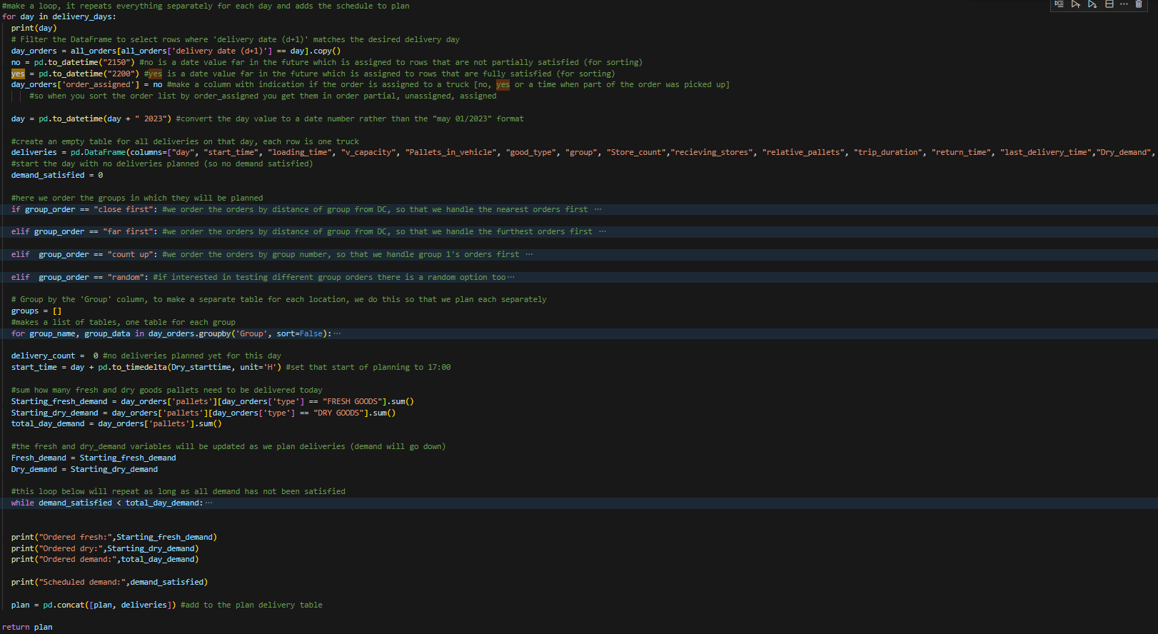
Step-by-Step Demonstration
For each day:

Slide 40
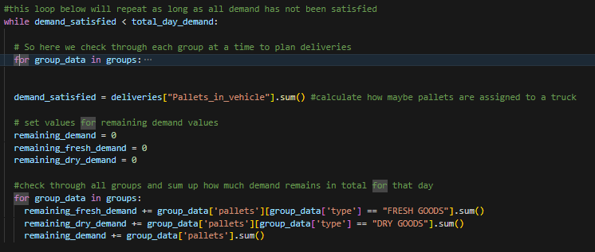
Step-by-Step Demonstration
Until planned pallets equals total demand for that day:

Slide 41
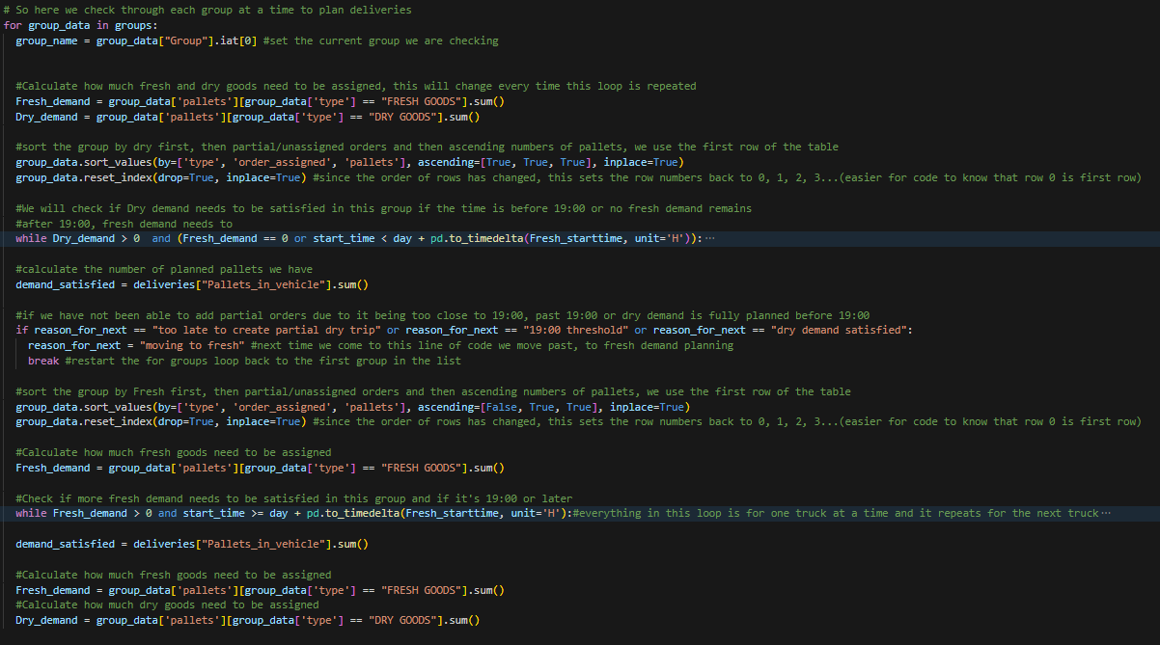
Step-by-Step Demonstration
For each group:

Slide 42
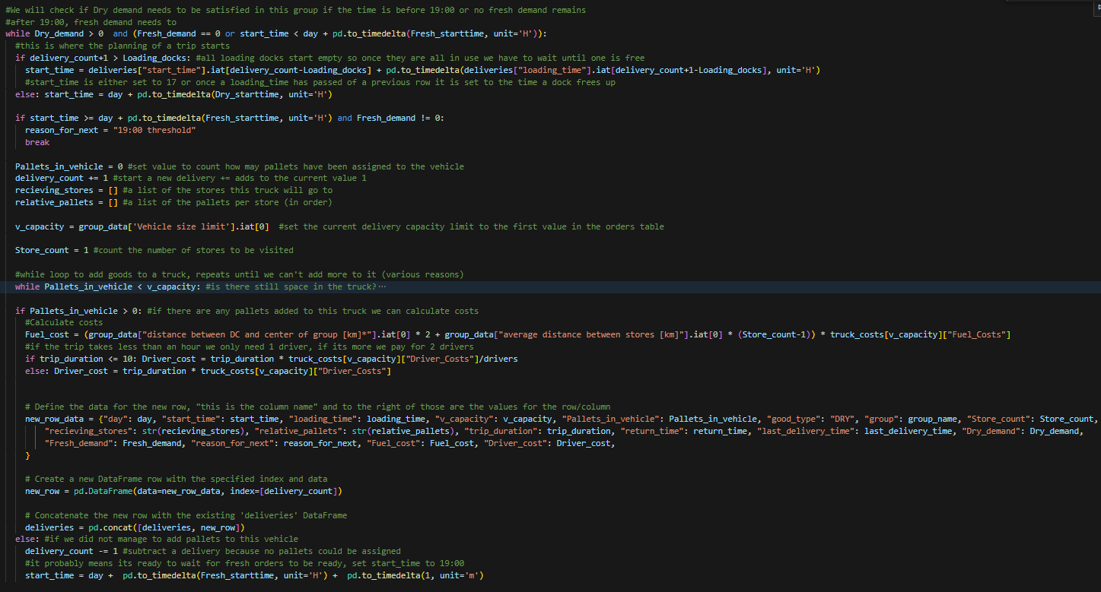
Step-by-Step Demonstration
Between 17:00 and 19:00 and after all fresh demand is planned:

Slide 43
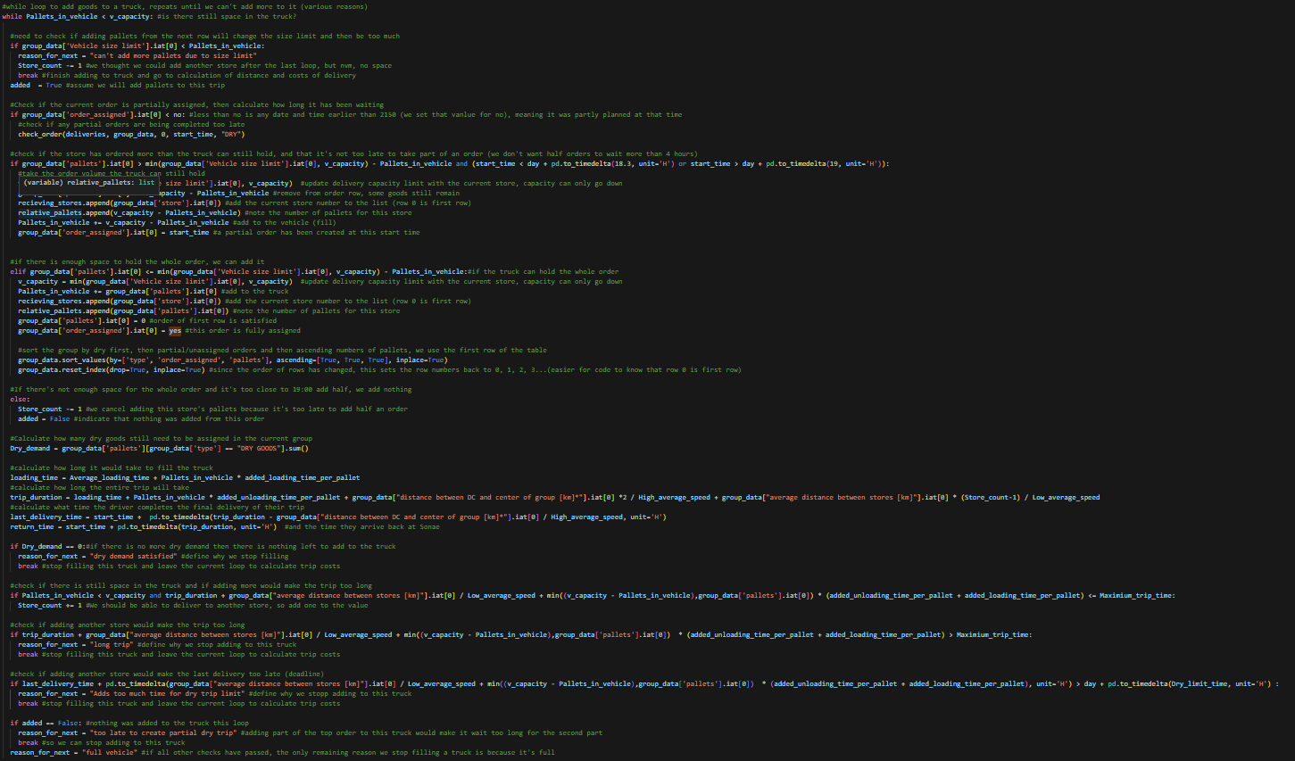
Step-by-Step Demonstration
Plan trips with dry goods

Slide 44
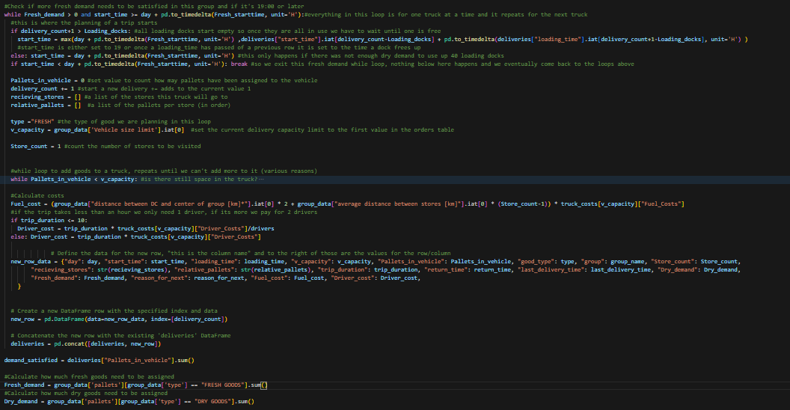
Step-by-Step Demonstration
After 19:00:

Slide 45
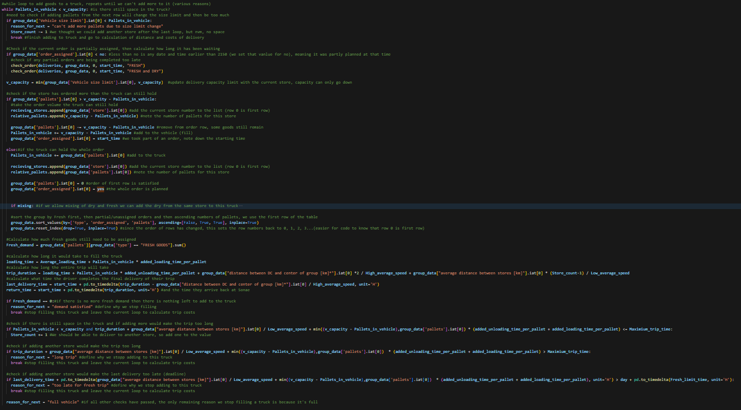
Step-by-Step Demonstration
Plan trips with fresh goods

Slide 46
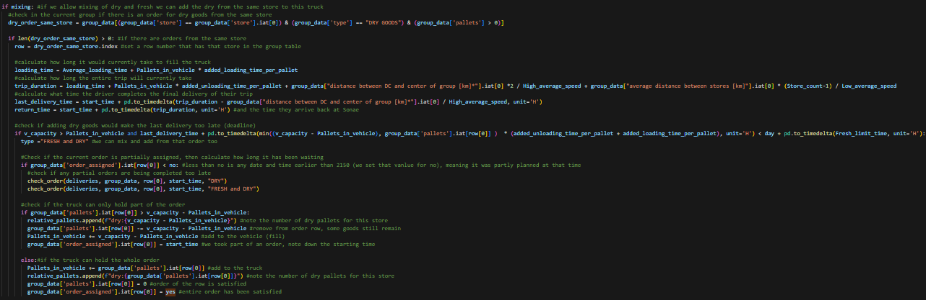
Step-by-Step Demonstration
And add dry if allowed

Slide 47
5. Solution Results & Analysis
‹#›

Slide 48
Deciphering Metrics: Analyzing and Explaining
Number of trips | Number of rows in the week plan, this is the total number of deliveries
fleet size 13 | Total number of 13_trucks, equals the maximum number of active trucks at any time
fleet size 24 | Total number of 24_trucks, equals the maximum number of active trucks at any time
fleet size 33 | Total number of 33_trucks, equals the maximum number of active trucks at any time
total fuel costs (€) | Sum of the fuel price of each trip planned, which is distance travelled multiplied by price
total driver costs (€) | Sum of the driver price of each trip planned, which is the wage(s) multiplied by trip duration
total vehicle costs (€) | Each of the fleet sizes multiplied by their respective vehicle prices and the number of days
total costs (€) | Sum of all total costs
last_fresh_delivery (time) | The time taken for the final truck of the week with fresh goods to complete final last delivery*
last_dry_delivery (time) | The time taken for the final truck of the week with dry goods to complete final last delivery*
(*Written as days HH:mm, where the deadline for fresh is 1 day 08:00 and dry is 2 days 00:00

Slide 49
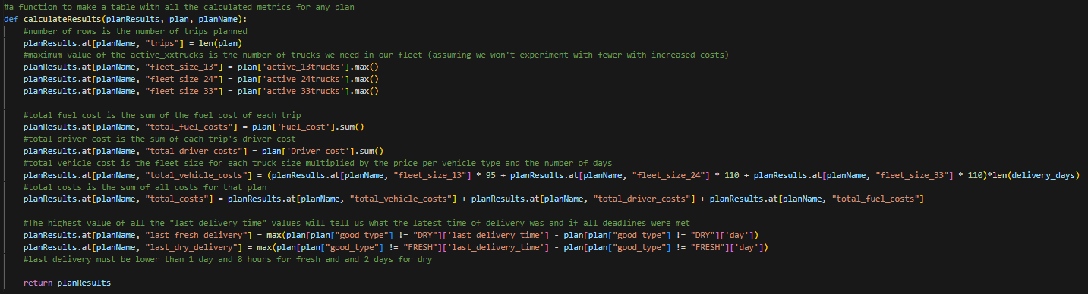
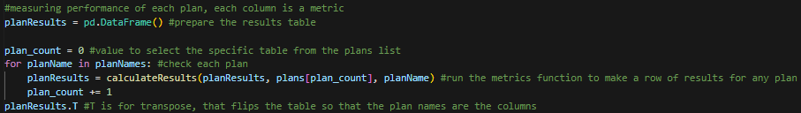
Function for making the results table:

Slide 50
Baseline Scenario Analysis: Single Driver, No Mix, Group Order Check
 | BASELINE CASE
Number of trips | 2049
fleet size 13 | 88
fleet size 24 | 34
fleet size 33 | 165
total fuel costs (€) | 219031.7
total driver costs (€) | 106665.35
total vehicle costs (€) | 181500
total costs (€) | 507197.05
last_fresh_delivery (time) | 1 day, 03:50:59
last_dry_delivery (time) | 1 day, 06:09:39
Parameters
1 driver
No mixing dry and fresh
Check groups in ascending number order
Results are for the entire week of orders:

Slide 51
Comparing Baseline to Initial Alternative: Single Driver, No Mixing
Green = improvement | Baseline Case | 1 driver, no mixing
Number of trips | 2049 | 2041
fleet size 13 | 88 | 97
fleet size 24 | 34 | 31
fleet size 33 | 165 | 165
total fuel costs (€) | 219031.70 | 218727.05
total driver costs (€) | 106665.35 | 106728.42
total vehicle costs (€) | 181500.00 | 184650.00
total costs (€) | 507197.05 | 510105.47
last_fresh_delivery (time) | 1 day, 03:50:59 | 1 day 04:48:39
last_dry_delivery (time) | 1 day, 06:09:39 | 1 day 05:57:39
The only difference in setup is the order in which the groups are treated.
In the baseline it plans for groups in numerical order, for the second option they are planned in order distance to the DC, nearest first.
Results are similar:
having fewer trips saves on fuel costs for the alternative
due to a larger fleet size the alternative is more expensive overall
→ We keep the baseline for the next to minimize cost.

Slide 52
Baseline vs. 2nd Alternative: Group Order Sequence Change
Green = improvement | Baseline Case | 1 driver, no mixing
Number of trips | 2049 | 1897
fleet size 13 | 88 | 96
fleet size 24 | 34 | 26
fleet size 33 | 165 | 152
total fuel costs (€) | 219031.70 | 183397.95
total driver costs (€) | 106665.35 | 94441.34
total vehicle costs (€) | 181500.00 | 172200.00
total costs (€) | 507197.05 | 450039.29
last_fresh_delivery (time) | 1 day, 03:50:59 | 1 day 04:36:59
last_dry_delivery (time) | 1 day, 06:09:39 | 1 day 06:20:19
The difference in setup is the order in which the groups are treated.
In the baseline it plans for groups in numerical order, for the second option they are planned in order distance to the DC, nearest first.
Also when planning fresh orders it checks if dry orders can be added from the same store.
Results are better in the alternative:
having fewer trips and a smaller fleet size saves on fuel costs
mixing fresh and dry leads to later final deliveries but the deadlines are still adhered to

Slide 53
Comparing 2nd to 3rd Alternative: Driver Flexibility & Order Adaptation
Green = improvement | 1 driver, mixing | 2 drivers, no mixing
Number of trips | 1897 | 1865
fleet size 13 | 96 | 97
fleet size 24 | 26 | 32
fleet size 33 | 152 | 147
total fuel costs (€) | 183397.95 | 186609.95
total driver costs (€) | 94441.34 | 135129.07
total vehicle costs (€) | 172200.00 | 173430.00
total costs (€) | 450039.29 | 495169.02
last_fresh_delivery (time) | 1 day 04:36:59 | 1 days 07:59:16
last_dry_delivery (time) | 1 day 06:20:19 | 1 days 10:36:15
The difference in setup is the number of drivers permitted.
If a trip takes longer than 10 hours a second driver can be added.
Also the first option checks if dry orders can be added from the same store when planning fresh orders.
Results are better in the 2nd alternative:
costs are lower across the board, especially driver costs
last delivery times are also much later in the second alternative due to allowing for 20 hour trips

Slide 54
Contrasting 2nd to 4th Alternative: Extended Trip Duration & Driver Flexibility
Green = improvement | 1 driver, mixing | 2 drivers, mixing
Number of trips | 1897 | 1831
fleet size 13 | 96 | 96
fleet size 24 | 26 | 28
fleet size 33 | 152 | 141
total fuel costs (€) | 183397.95 | 172305.35
total driver costs (€) | 94441.34 | 112569.66
total vehicle costs (€) | 172200.00 | 166260.00
total costs (€) | 450039.29 | 451135.01
last_fresh_delivery (time) | 1 day 04:36:59 | 1 days 06:02:19.
last_dry_delivery (time) | 1 day 06:20:19 | 1 days 13:11:55.
The difference in setup is the number of drivers permitted.
If a trip takes longer than 10 hours a second driver can be added and the limit becomes 20 hours.
Results are slightly better in the 2nd alternative
driver costs are lower, significantly lowering total costs
for two drivers fewer trips are needed, lowering fuel vehicle costs
last delivery times are also much later in the 4th alternative due to allowing for 20 hour trips

Slide 55
Alternative Comparison: Exploring Delivery Planning Scenarios
 | Baseline Case | 1 driver, no mixing | 1 driver, mixing | 2 drivers, no mixing | 2 driver, mixing
Number of trips | 2049 | 2041 | 1897 | 1865 | 1831
fleet size 13 | 88 | 97 | 96 | 97 | 96
fleet size 24 | 34 | 31 | 26 | 32 | 28
fleet size 33 | 165 | 165 | 152 | 147 | 141
total fuel costs (€) | 219031.70 | 218727.05 | 183397.95 | 186609.95 | 172305.35
total driver costs (€) | 106665.35 | 106728.42 | 94441.34 | 135129.07 | 112569.66
total vehicle costs (€) | 181500.00 | 184650.00 | 172200.00 | 173430.00 | 166260.00
total costs (€) | 507197.05 | 510105.4667 | 450039.29 | 495169.02 | 451135.01
last_fresh_delivery (time) | 1.160416667 | 1.200462963 | 1.192361111 | 1.332824074 | 1.25162037
last_dry_delivery (time) | 1.256712963 | 1.24837963 | 1.26412037 | 1.441851852 | 1.549953704

Slide 56

Result-Driven Conclusions: Insights Drawn from Analysis
Allowing trips after 19:00 to include dry and fresh goods has the most impact on fleet size and overall costs, although slightly slowing down the arrival of the last fresh orders
Allowing 2 drivers on a delivery results in fewer deliveries being needed and a slightly smaller fleet size but due to increased driver costs the total cost is increased.
However, allowing for 2 drivers might perform better with some parameter tuning, or even in combination with cross-docking
Next we can look at ordering the groups

Slide 57

Result-Driven Conclusions: Ordering Groups
It appears to be impactful which groups are addressed first.
The baseline case puts groups in numerical order and was slightly cheaper.
→ Using the best performing alternative we will do a quick comparison of:
Counting up in group number
Ordering by furthest first
Random orders each day

Slide 58
Alternative Comparison: Different Group Orders
 | no Mix, 1 driver, Close 1st | no Mix, 1 driver, Count up | no Mix, 1 driver, Far 1st | no Mix, 1 driver, Random
Number of trips | 1897 | 1952 | 2046 | 1924
fleet size 13 | 99 | 87 | 81 | 108
fleet size 24 | 26 | 29 | 28 | 26
fleet size 33 | 153 | 162 | 182 | 164
total fuel costs (€) | 183393.9 | 196144.1 | 214751.6 | 189078.3
total driver costs (€) | 94441.34 | 98447.8 | 102914.9 | 95941.63
total vehicle costs (€) | 174570 | 175650 | 184770 | 186960
total costs (€) | 452405.2 | 470241.9 | 502436.5 | 471979.9
last_fresh_delivery (time) | 1 days 04:36:59 | 1 days 04:49:59 | 1 days 02:58:59 | 1 days 04:22:19
last_dry_delivery (time) | 1 days 06:20:19 | 1 days 05:37:59 | 1 days 08:24:27 | 1 days 07:04:47
The original optimal is still the best, although delivering to the far locations first makes the final fresh delivery arrive earlier.

Slide 59
Should we adjust Fleet size?
Right now fleet size for each truck type is the maximum number in use at any point in the week..
So we are paying daily price for trucks that are not always being used that day.
We could reduce the fleet size and do the following when the active trucks exceeds the fleet:
“Occasional trucks may be considered beyond the regular fleet for specific days. For those vehicles, all costs must be increased by +30%”

Slide 60
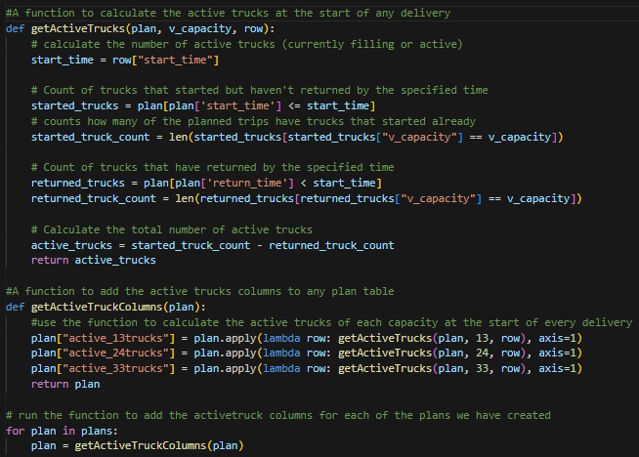
Function to calculate how many of each truck type is active when a delivery starts:
This creates the columns in the plan table with the number of active trucks.
Each column is plotted over time in the following slides:

Slide 61
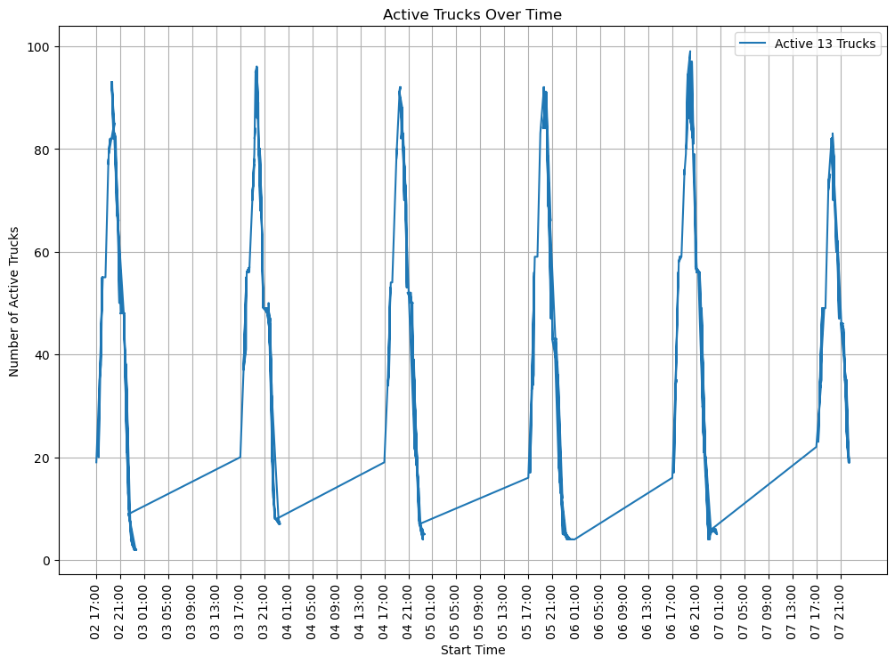
Consistent 13-Capacity Truck Fleet: Cost Optimization with Variable Usage
Each day the fleet size is quite consistent but slight variation might mean you can save money on days where fewer trucks are needed.

Slide 62
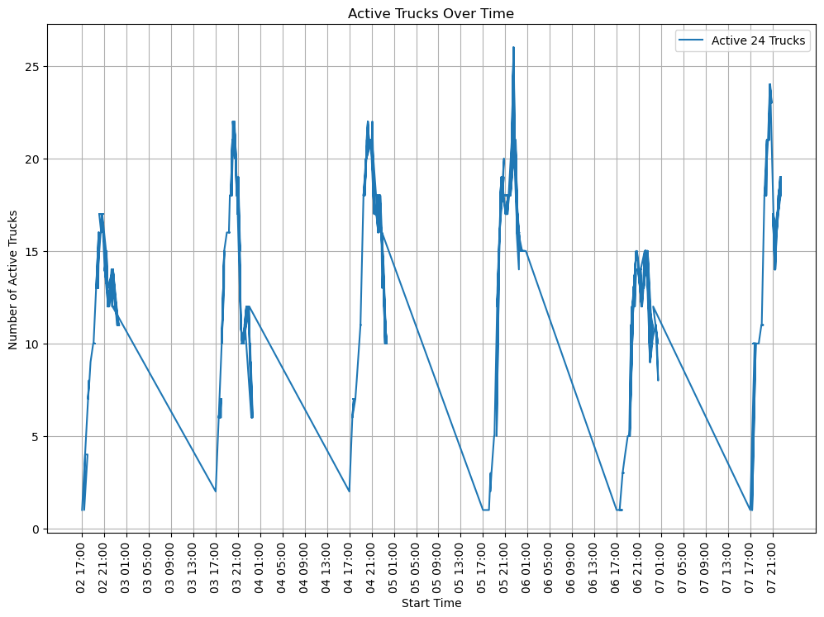
Flexible 24-Capacity Truck Fleet: Cost-Efficient Variability in Usage
Each day the fleet size varies more than for other trucks, this variation means you can save money on days where fewer trucks are needed

Slide 63
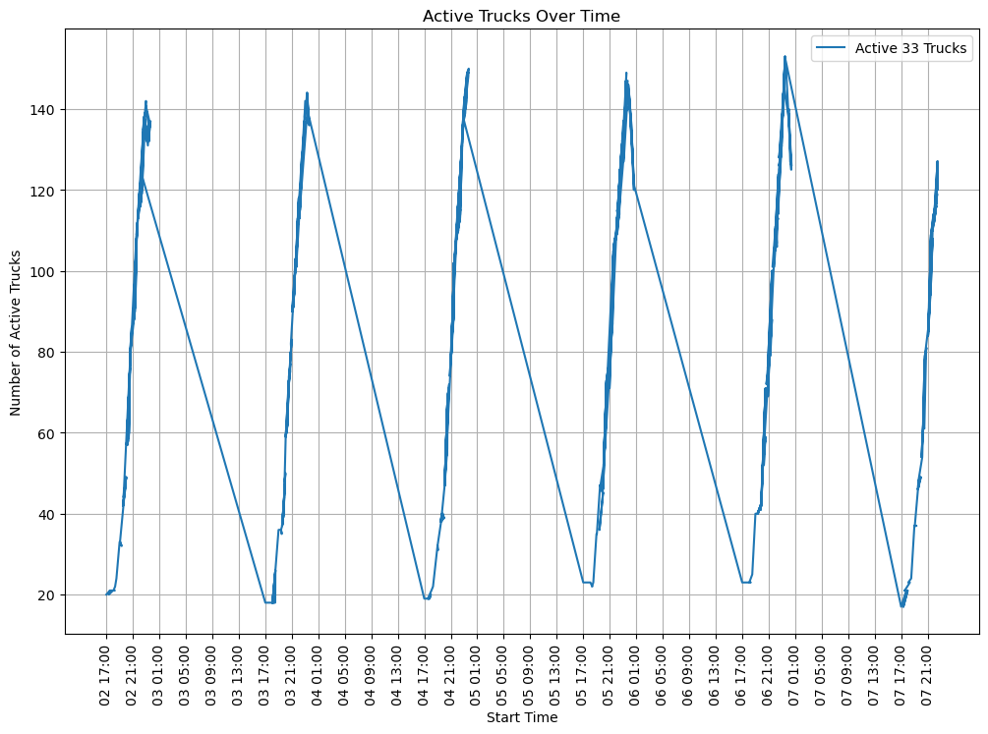
Stable 33-Capacity Truck Fleet: Cost Analysis in Minimal Variance
Each day the fleet size varies very little, this likely means that reducing the fleet size will increase costs

Slide 64
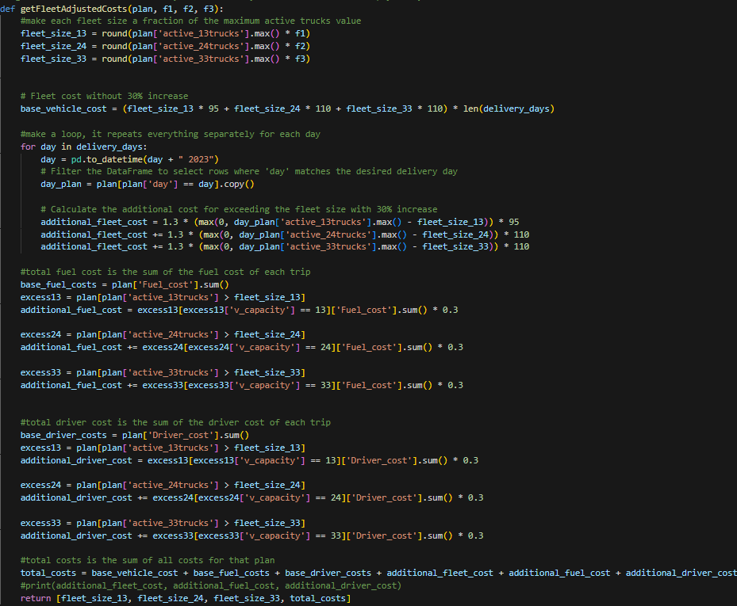
Cost Efficiency Through Fleet Size Reduction
If you reduce fleet size…
…you save on vehicle costs
BUT
… you pay 30% more any time that more trucks are needed
The costs resulting from this code are plotted in the following slides:

Slide 65
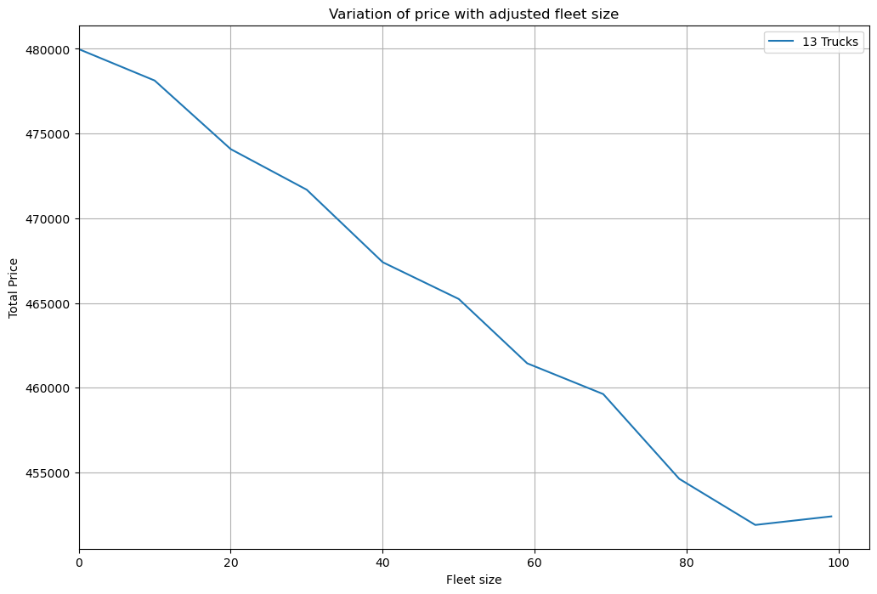
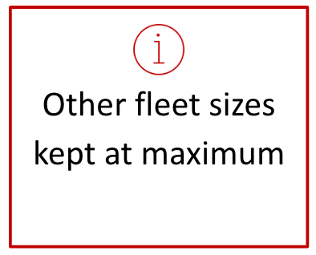
Cost Efficiency Through Fleet Size Reduction – 13 Trucks

Slide 66
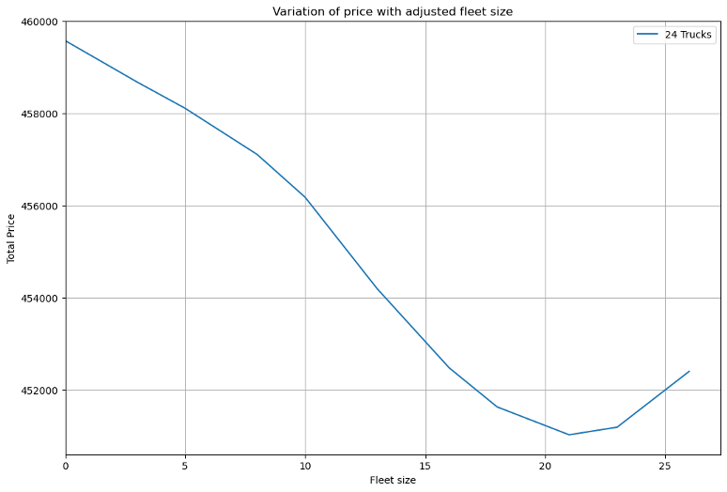
Cost Efficiency Through Fleet Size Reduction – 24 Trucks

Slide 67
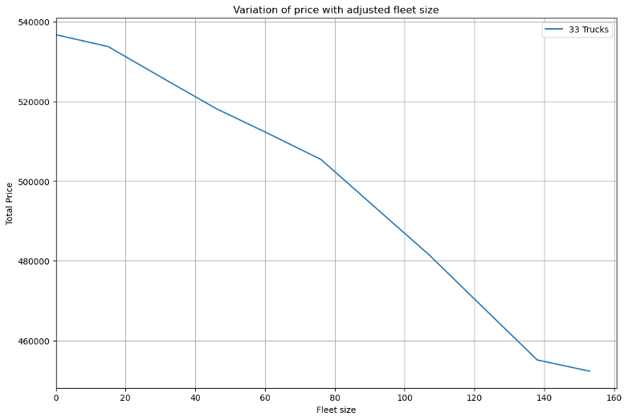
Cost Efficiency Through Fleet Size Reduction – 33 Trucks
Other fleet sizes kept at maximum

Slide 68
Outcome Overview: Analyzing Results
It’s heavily dependent on how frequently the truck type is used, 33 size trucks are the most regularly used so there is more clarity for their optimal fleet size.
Optimal Planning Guidance:
Assuming that our planning is optimal and each week is similar in orders we advise to utilize a slightly smaller fleet size for 13 and 24 size trucks for lower costs, as shown in the table below:
 | Fleet 13 | Fleet 24 | Fleet 33 | Cost (euro)
Max | 99 | 26 | 153 | 452405.24
Optimal | 89 | 21 | 153 | 450527.33

Slide 69
6. Solution Evaluation
‹#›

Slide 70
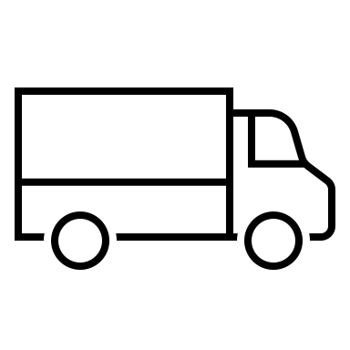


Comprehensive Solutions and Recommendations
Network
Process
Sustainability
There are no savings on journeys from the cross-docking station, so we recommend working without it.
Utilize a slightly smaller fleet size for 13 and 24 size trucks for lower costs.
See the attached excel delivery planning or
use our python function to plan deliveries
Cross-docking platforms?
Store differences?
Mix dry with fresh goods after 19:00 if a fresh delivery is planned to the same store.
Mix fresh with dry goods if a fresh delivery is planned to the same store
Transition to electric vehicles could be a strategic move and brings tangible benefits in terms of cost, reputation, and long-term operational resilience.

Slide 71
How to improve?
When using 2 drivers we should consider if a trip of 11 hours is worth 2 drivers, this option may not be explored enough.
This is a bottom up approach, there may be better solutions than those generated by our code. However, the produced plans meet the success criteria.
Costs and savings of cross-docking are just estimates, research into this could be deepened to find the exact impacts.

Slide 72
Appendix
‹#›

Slide 73
Sustainability Strategies - Practical Advice
Electric Vehicles (EVs):
An adoption of electric vehicles (EVs) in distribution offers a many advantages, strategically positioning the company for sustainable growth and operational efficiency. Some of the advantages:
Environmental Responsibility: By reducing emissions, Sonae's use of EVs demonstrates a commitment to environmental responsibility, aligning with global sustainability goals such as the UN:s 2030 Agenda and ensuring compliance with regulatory standards.
Economical Advantages: Electric vehicles contribute to financial efficiency by offering lower operating and maintenance costs. The initial investment is offset by reduced fuel expenses and maintenance requirements, resulting in long-term financial benefits.
Government Incentives: Sonae can take advantage of subsidies and incentives provided by the Portuguese government to promote and facilitate the adoption of electric vehicles, further optimizing the economic aspects of the transition.
Brand Image Enhancement: Operating a fleet of electric vehicles enhances Sonae's brand image. The company becomes synonymous with eco-friendly practices, appealing to environmentally conscious consumers and fostering a positive reputation in the market.
In summary, Sonae's transition to electric vehicles is a strategic move that not only addresses environmental concerns but also brings about tangible benefits in terms of cost, reputation, and long-term operational resilience.

